Slide 1

Let’s know when to water plants

Slide 2

What we are going to do?
Here we are going to sense the moistures of soil and based on the input we are going to send a message through bluetooth module to connected device whether to water the plant or not.
Components required:
Arduino Uno board
Soil moisture sensor
Bluetooth module
Battery(9V-12V)
Jumper Cables
LED
2

Slide 3
How Soil Moisture Sensor works?
The working of the soil moisture sensor is pretty simple and straightforward, as you can see in the image below. We just need to stick the fork-shaped conductive probe to the soil, as the probe has two exposed conductive plates that will act as a variable resistor whose resistance will vary depending on the water content in the soil. This resistance of the probe is inversely proportional to the soil moisture of the device. The more water in the soil the better the conductivity which will result in lower resistance. The less the water in the soil the poor the conductivity which means higher resistance. This sensor produces an output voltage according to the resistance by measuring which we can determine the moisture level.The entire soil moisture sensor consists of two parts:
->The first one is the soil moisture sensor probe and the second one is an electronic module.
->The module processes the incoming data from the probe and that gets processed by a microcontroller like Arduino and we get the final output.
3

Slide 4
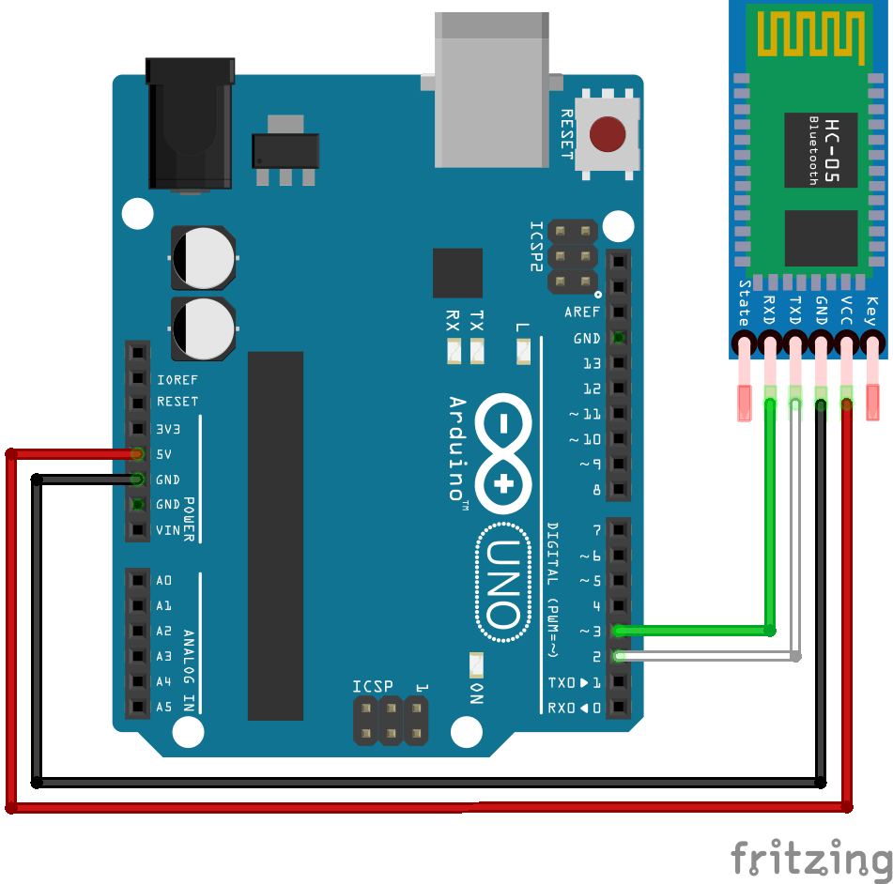
Bluetooth Module
The measuring unit it's based on Arduino Uno and it transmits data to a mobile phone using a HC-05 bluetooth module.
For receiving data you can use Blueserial app or Serial Bluetooth Terminal. I used the last one. It's easy to use and has a pretty good interface.
App link:
https://play.google.com/store/apps/details?id=com.frederikhauke.ArduTooth
4

Slide 5
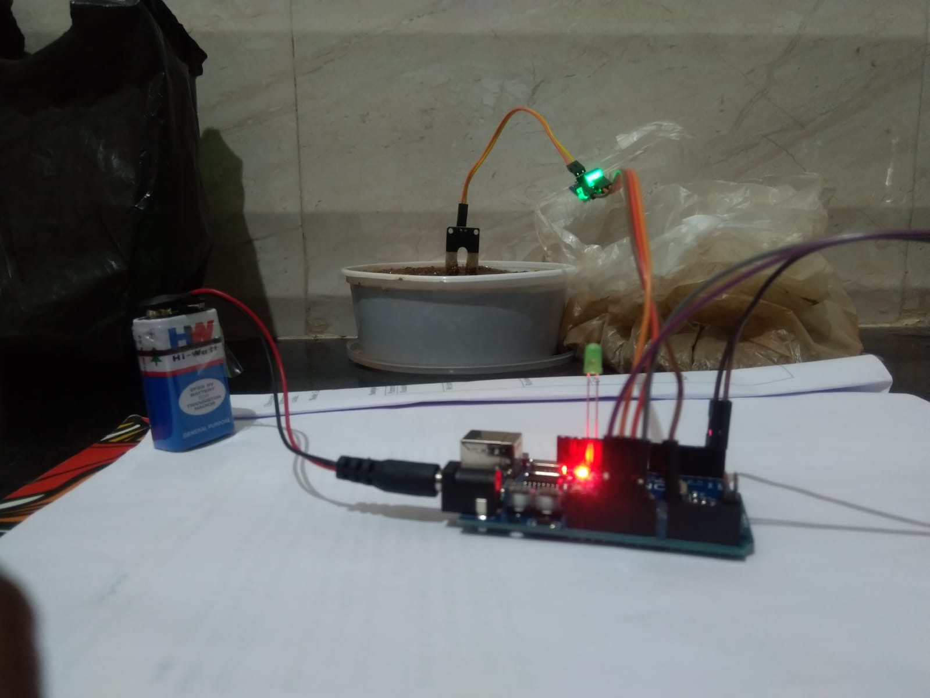
CONNECTIONS
Bluetooth module (Real Time Clock)
GND → ground pin
VCC → 5V pin
RXD → TXD
TXD → RXD
Soil Moisture sensor
GND → ground pin
VCC → 3.3V pin
A0 → A1
5

Slide 6
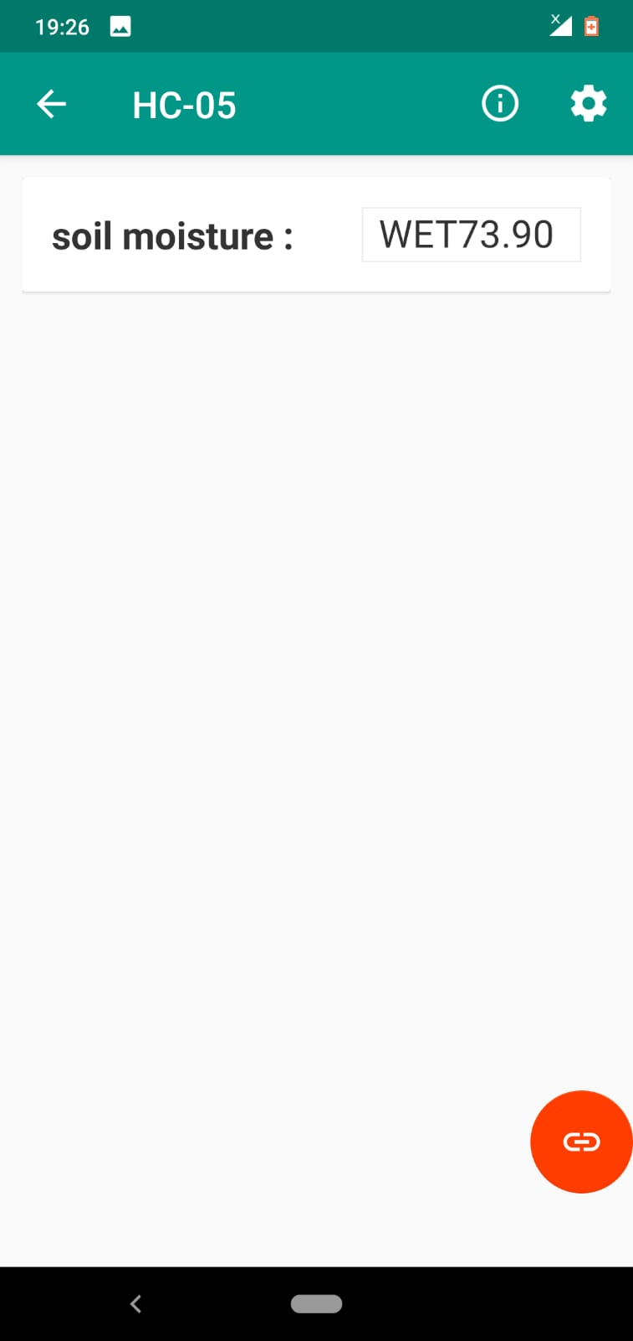

Conversations
Here, the analog output of soil moisture sensor is processed using ADC. The moisture content in terms of percentage is displayed on the serial monitor. The output of the soil moisture sensor changes in the range of ADC value from 0 to 1023. This can be represented as moisture value in terms of percentage using formula given below.
Moisture in percentage = 100 – (Analog output * 100) For zero moisture, we get maximum value of 10-bit ADC, i.e. 1023.
This, in turn, gives 0% moisture.
The measuring value was divided in to 4 parts: 0% - 25% =Dry
26% - 50% = Low wet
51% - 75% = moderate wet
76% - 100% = High wet
6

Slide 7

THANK YOU

